Slide 1

APEX INSTITUTE OF TECHNOLOGY
DEPARTMENT OF COMPUTER SCIENCE & ENGINEERING
MACHINE LEARNING (21CSH-286)
Faculty: Prof. (Dr.) Vineet Mehan (E13038)
Lecture – 5
Encoding Categorical Data
DISCOVER . LEARN . EMPOWER

Slide 2
DBMS: Course Objectives
COURSE OBJECTIVES
The Course aims to:
Understand and apply various data handling and visualization techniques.
Understand about some basic learning algorithms and techniques and their applications, as well as general questions related to analysing and handling large data sets.
To develop skills of supervised and unsupervised learning techniques and implementation of these to solve real life problems.
To develop basic knowledge on the machine techniques to build an intellectual machine for making decisions behalf of humans.
To develop skills for selecting suitable model parameters and apply them for designing optimized machine learning applications.

Slide 3
COURSE OUTCOMES
On completion of this course, the students shall be able to:-
CO1 | Understand machine learning techniques and computing environment that are suitable for the applications under consideration.

Slide 4
Unit-1 Syllabus
Unit-1 | Introduction to Machine Learning
Introduction to Machine Learning | Definition of Machine Learning, Working principles of Machine Learning; Classification of Machine Learning algorithms: Supervised Learning, Unsupervised Learning, Reinforcement Learning, Semi-Supervised Learning; Applications of Machine Learning.
Data Pre-Processing and Feature Extraction | Data Sourcing and Cleaning, Handling Missing data, Encoding Categorical data, Feature Scaling, Handling Time Series data; Feature Selection techniques, Data Transformation, Normalization, Dimensionality reduction
Data Visualization | Data Frame Basics, Different types of analysis, Different types of plots, Plotting fundamentals using Matplotlib, Plotting Data Distributions using Seaborn.

Slide 5
SUGGESTIVE READINGS
TEXT BOOKS:
There is no single textbook covering the material presented in this course. Here is a list of books recommended for further reading in connection with the material presented:
T1: Tom.M.Mitchell, “Machine Learning, McGraw Hill International Edition”.
T2: Ethern Alpaydin,” Introduction to Machine Learning. Eastern Economy Edition, Prentice Hall of India, 2005”.
T3: Andreas C. Miller, Sarah Guido, Introduction to Machine Learning with Python, O’REILLY (2001).
REFERENCE BOOKS:
R1 Sebastian Raschka, Vahid Mirjalili, Python Machine Learning, (2014)
R2 Richard O. Duda, Peter E. Hart, David G. Stork, “Pattern Classification, Wiley, 2nd Edition”.
R3 Christopher Bishop, “Pattern Recognition and Machine Learning, illustrated Edition, Springer, 2006”.

Slide 6
Index
Categorical Data
Encoding
Categorical Encoding
Types of Categorical Encoding
Label Encoding
One-Hot Encoding
Ordinal Encoding

Slide 7
Categorical Data
Examples:
The city where a person lives: Delhi, Mumbai, Ahmedabad, Bangalore, etc.
The department a person works in: Finance, Human resources, IT, Production.
The highest degree a person has: High school, Diploma, Bachelors, Masters, PhD.
The grades of a student: A+, A, B+, B, B- etc.

Slide 8
Categorical Data
Data that is represented as ‘strings’ or ‘categories’ and are finite in number is called Categorical Data.
When your data has categories represented by strings, it will be difficult to use them to train machine learning models.
Why?
Machine learning models often accepts numeric data.

Slide 9
Categorical Data
How to train a ML model for Categorical Data?
Transform it.
How to transform?
Transform it using Encoding.

Slide 10
Encoding
Encoding means to convert data into a particular form.
Encoding Categorical data is a technique to convert categorical entry in a dataset to a numerical data.
Various types of encoding are:
Label Encoding
One-hot Encoding
Ordinal Encoding

Slide 11
1. Label Encoding
In Label Encoding, we need to replace the categorical value using a numerical value.
Ranging → 0-the total number of classes minus one.
For instance, if the value of the categorical variable has six different classes, we will use 0, 1, 2, 3, 4, and 5.

Slide 12
1. Label Encoding
State | Confirmed | Deaths | Recovered
Maharashtra | 284281 | 11194 | 158140
Tamil Nadu | 156369 | 2236 | 107416
Delhi | 118645 | 3545 | 97693
Karnataka | 51422 | 2089 | 19729
Gujarat | 45481 | 2089 | 32103
Uttar Pradesh | 43441 | 1046 | 26675
Covid-19 cases in India across states

Slide 13
1. Label Encoding
State (Nominal Scale) | State (Label Encoding)
Maharashtra | 3
Tamil Nadu | 4
Delhi | 0
Karnataka | 2
Gujarat | 1
Uttar Pradesh | 5

Slide 14
Program
We have created a dictionary 'data' and transformed it into a Data Frame with the help of the DataFrame() function of pandas.
import pandas as pd
my_data = {
"Gender" : ['F', 'M', 'M', 'F', 'M', 'F', 'M', 'F', 'F', 'M'],
"Name" : ['Shweta', 'Rohit', 'Abhay', 'Surbhi', 'Amit', 'Sara', 'Vicky', 'Mehak', 'Sita', 'Saurabh']
}
blk = pd.DataFrame(my_data)
print("Geniune Data Frame:\n")
print(blk)

Slide 15
Output
Gender Name
0 F Shweta
1 M Rohit
2 M Abhay
3 F Surbhi
4 M Amit
5 F Sara
6 M Vicky
7 F Mehak
8 F Sita
9 M Saurabh

Slide 16
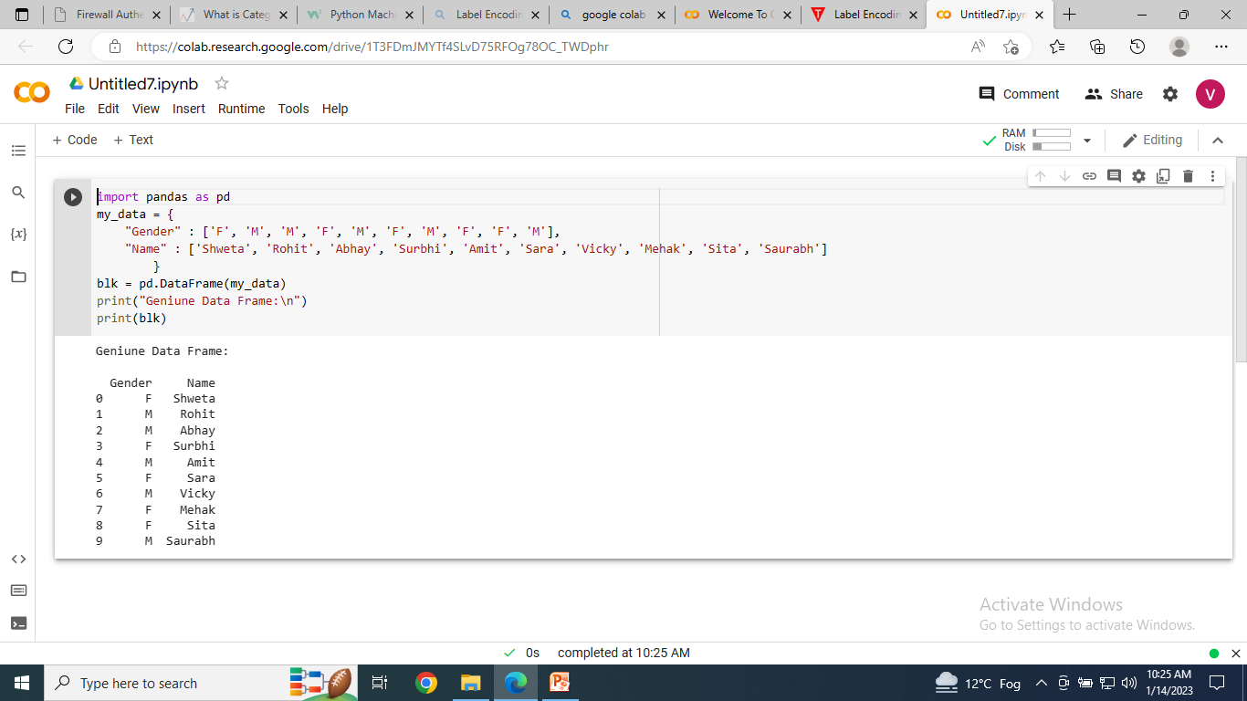

Slide 17
Program
import pandas and preprocessing modules of the scikit-learn library.
import pandas as pd
from sklearn import preprocessing
my_data = {
"Gender" : ['F', 'M', 'M', 'F', 'M', 'F', 'M', 'F', 'F', 'M'],
"Name" : ['Shweta', 'Rohit', 'Abhay', 'Surbhi', 'Amit', 'Sara', 'Vicky', 'Mehak', 'Sita', 'Saurabh']
}
blk = pd.DataFrame(my_data)
my_label = preprocessing.LabelEncoder()
blk[ 'Gender' ]= my_label.fit_transform(blk[ 'Gender' ])
print(blk[ 'Gender' ].unique())
print("Data Frame after Label Encoding:\n")
print( blk )
fit_transform() method in order to add label encoder functionality pointed by the object to the data variable.

Slide 18
Output
Gender Name
0 0 Shweta
1 1 Rohit
2 1 Abhay
3 0 Surbhi
4 1 Amit
5 0 Sara
6 1 Vicky
7 0 Mehak
8 0 Sita
9 1 Saurabh

Slide 19
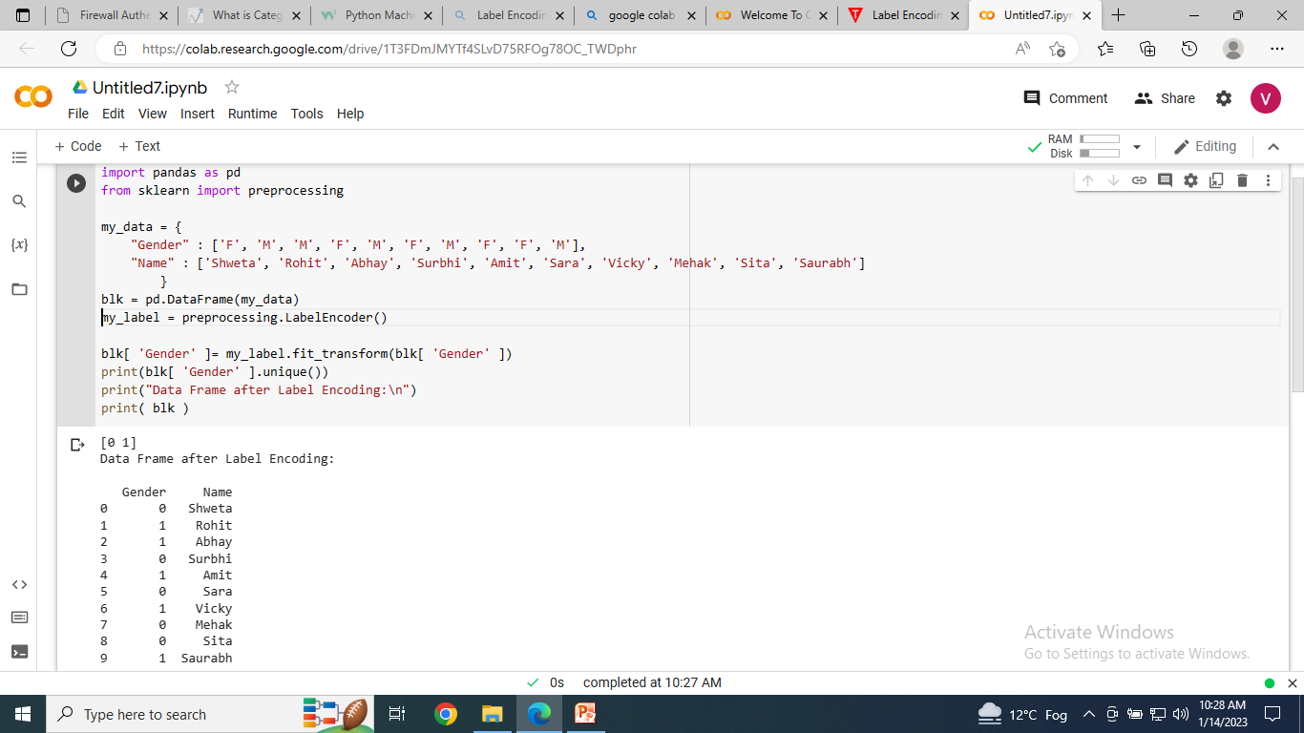

Slide 20
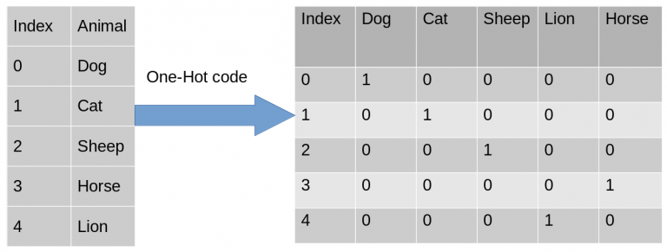
2. One-hot Encoding
Each category is mapped with a binary variable.
Suppose we have a dataset with a category animal, having different animals like Dog, Cat, Sheep, Cow, Lion.

Slide 21
Program
import pandas as pd
#create DataFrame
df = pd.DataFrame({'team': ['A', 'A', 'B', 'B', 'B', 'B', 'C', 'C'],
'points': [25, 12, 15, 14, 19, 23, 25, 29]})
#view DataFrame
print(df)

Slide 22
Output
team points
0 A 25
1 A 12
2 B 15
3 B 14
4 B 19
5 B 23
6 C 25
7 C 29

Slide 23
Program
import pandas as pd
#create DataFrame
df = pd.DataFrame({'team': ['A', 'A', 'B', 'B', 'B', 'B', 'C', 'C'],
'points': [25, 12, 15, 14, 19, 23, 25, 29]})
from sklearn.preprocessing import OneHotEncoder
#creating instance of one-hot-encoder
encoder = OneHotEncoder(handle_unknown='ignore')

Slide 24
Program
#perform one-hot encoding on 'team' column
encoder_df = pd.DataFrame(encoder.fit_transform(df[['team']]).toarray())
#merge one-hot encoded columns back with original DataFrame
final_df = df.join(encoder_df)
#view final df
print(final_df)

Slide 25
Output
team points 0 1 2
0 A 25 1.0 0.0 0.0
1 A 12 1.0 0.0 0.0
2 B 15 0.0 1.0 0.0
3 B 14 0.0 1.0 0.0
4 B 19 0.0 1.0 0.0
5 B 23 0.0 1.0 0.0
6 C 25 0.0 0.0 1.0
7 C 29 0.0 0.0 1.0

Slide 26
Drop the original Column Team
#drop 'team' column
final_df.drop('team', axis=1, inplace=True)
#view final df
print(final_df)

Slide 27
Final Output
points 0 1 2
0 25 1.0 0.0 0.0
1 12 1.0 0.0 0.0
2 15 0.0 1.0 0.0
3 14 0.0 1.0 0.0
4 19 0.0 1.0 0.0
5 23 0.0 1.0 0.0
6 25 0.0 0.0 1.0
7 29 0.0 0.0 1.0

Slide 28
3. Ordinal Encoding
Ordinal Encoding is similar to Label Encoding where we take a list of categories and convert them into integers.
However, unlike Label Encoding, we preserve and order.
For example, if we are encoding rankings of 1st place, 2nd place, etc, there is an inherit order.

Slide 29
Program
# example of a ordinal encoding
from numpy import asarray
from sklearn.preprocessing import OrdinalEncoder
# define data
data = asarray([['red'], ['green'], ['blue']])
print(data)

Slide 30
Program
# define ordinal encoding
encoder = OrdinalEncoder()
# transform data
result = encoder.fit_transform(data)
print(result)

Slide 31
Output
[['red']
['green']
['blue']]
[[2.]
[1.]
[0.]]

Slide 32
Summary
Categorical Data
Encoding
Categorical Encoding
Types of Categorical Encoding

Slide 33
Task
Apply the ordinal encoding technique on a suitable dataset and get the required result. (BT-Level3)

Slide 34
REFERENCES
https://www.analyticsvidhya.com/blog/2020/08/types-of-categorical-data-encoding/
https://www.w3schools.com/python/python_ml_preprocessing.asp
https://www.javatpoint.com/label-encoding-in-python
https://www.statology.org/one-hot-encoding-in-python/

Slide 35
THANK YOU
For queries
Email: vineet.e13038@cumail.in

